Slide 1
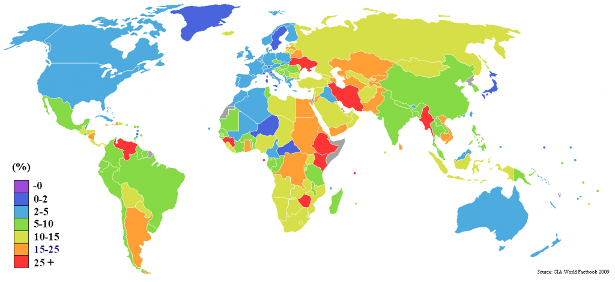
Monthly Global CPI Price
By: Michael Ryvin and Karishni Patel

Slide 2
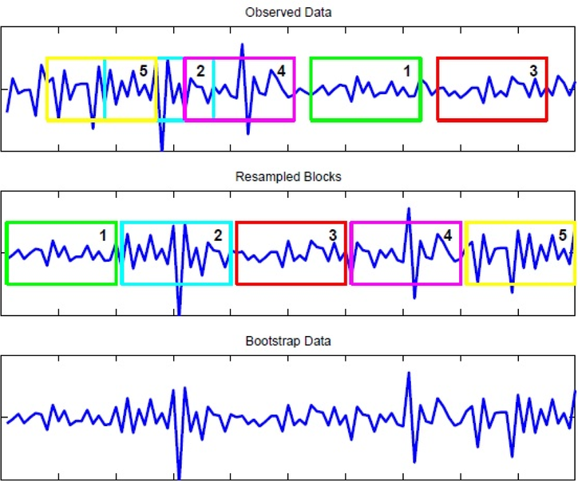
Introduction
The purpose of this project is to apply a moving block bootstrap to monthly Consumer Price Index prices of different countries grouped by development, region, and income.

Slide 3
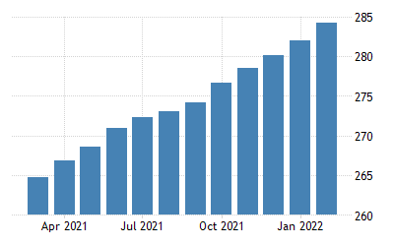
Hypothesis
If we forecast CPI from 1989 to 2019, then we will see an increase in the average change in prices in high, middle, and developing countries.

Slide 4
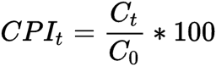
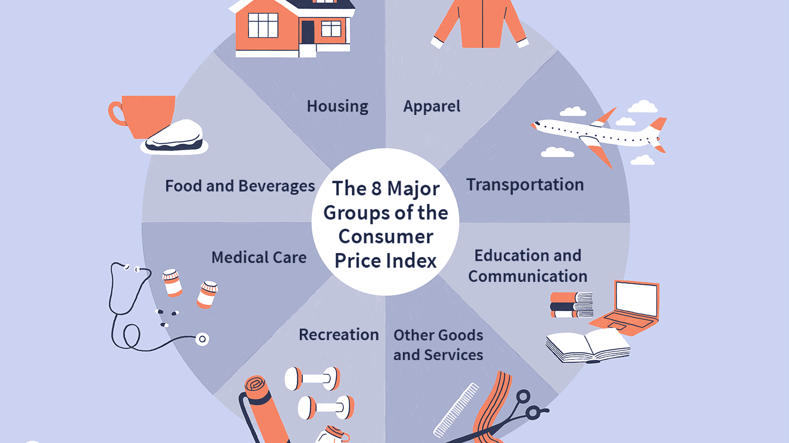
What is CPI? How is it measured?
The Consumer Price Index (CPI) is a measure that examines the weighted average of prices of a basket of consumer goods and services, such as transportation, food, and medical care.
It is calculated by taking price changes for each item in the predetermined basket of goods and averaging them.

Slide 5

The Dataset
We got our dataset from: https://www.kaggle.com/datasets/theworldbank/global-economic-monitor (monthly)
Providing daily updates of global economic developments, with coverage of high income as well as developing countries.
Daily data updates are provided for exchange rates, equity markets, and emerging market bond indices.
Monthly data coverage (updated daily and populated upon availability) is provided for consumer prices, high-tech market indicators, industrial production and merchandise trade.

Slide 6
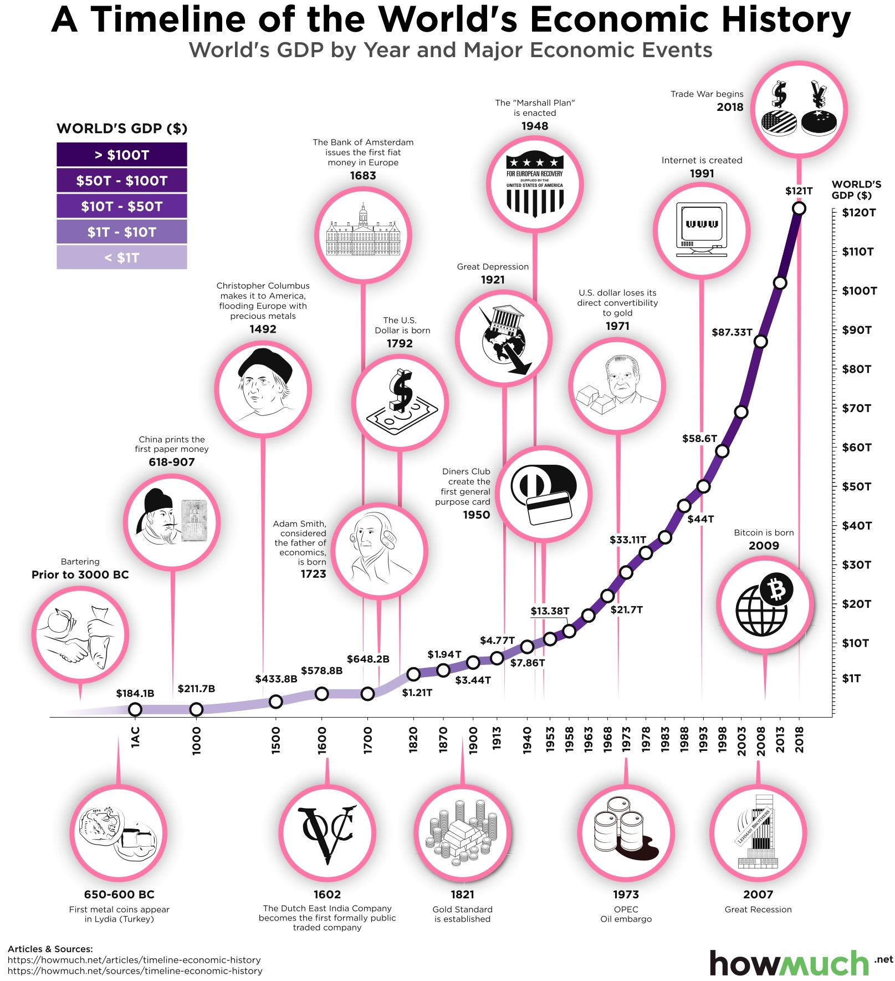
Cleaning the Dataset
Removed the low income country column because a lot of the data was missing and there were a lot of negative values
Removed the last month because there were missing values
Created three subsets for several time periods(1989-2019, 2012-2019, 2017-2019)

Slide 7
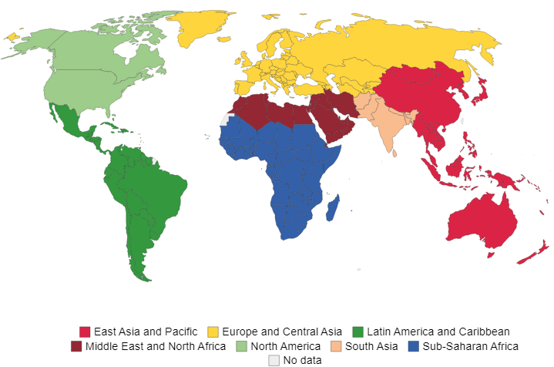
Regions in the Dataset
Developing Countries
Developing Asia
East Asia/Pacific Developing
Europe/Central Asia Developing
Latin America/Caribbean Developing
South Asia Developing
Sub-Saharan Africa Developing
Middle East/North Africa Developing
High Income Countries
High Income OECD Countries
High Income Non-OECD Countries
Middle Income Countries
Low Income Countries

Slide 8

R Code
for(w in 2:15) {
start <- tsp(ts(my_data[[w]],frequency = 12))[2]-1
#Skip because not enough data
if(w==9) {
next
}
sim <- bld.mbb.bootstrap(ts(my_data[[w]],frequency = 12), 10) %>%
as.data.frame() %>%
ts(frequency=12, start=1989.5)
fc <- purrr::map(as.list(sim),
function(x){forecast(ets(x))[["mean"]]}) %>%
as.data.frame() %>%
ts(frequency=12, start=start+1989.5)
print(autoplot(ts(my_data[[w]],frequency = 12,start=1989.5)) +
autolayer(sim, colour=TRUE) +
autolayer(fc, colour=TRUE) +
autolayer(ts(my_data[[w]],frequency = 12,start=1989.5), colour=FALSE) +
ylab("Consumer Price Index") +
guides(colour="none") + ggtitle(names(my_data[w])) )
cat("The average predicted value for", names(my_data3[w]), "is:", mean(fc), "\n" )
cat("The standard deviation of the predicted value for", names(my_data3[w]), "is:", sd(fc) )
}

Slide 9
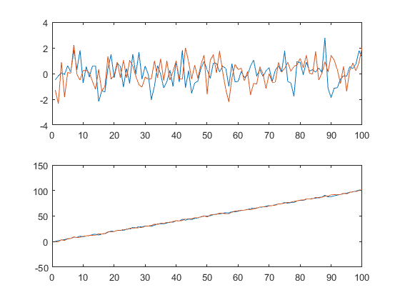
The Box-Cox and Loess Moving Block Bootstrap
The time series is Box-Cox transformed then decomposed into trend, seasonal, and random variation components
Random variation components are bootstrapped from contiguous sections of the time series and joined together
Trend and seasonal components are combined with bootstrap variation components, Box-Cox transform inverted

Slide 11
Purpose of Moving Block Bootstrap
Time series models have at least four sources of uncertainty:
Random error
Parameter estimate error
Model choice
Assumption of correlation between historical and future data
Moving bootstraps use “bagging” (bootstrap aggregating) and take into account (a) and (b) whereas traditional models only incorporate (a)
This project used 10 simulations each with different parameter estimates

Slide 12
 | 1989-2019 |  | 2012-2019 |  | 2017-2019
Region | Mean | SD | Mean | SD | Mean | SD
Developing Asia | 2.622865 | 0.4238488 | 2.664424 | 0.2242972 | 2.904942 | 0.1968006
Developing Countries | 3.031491 | 0.228516 | 2.956536 | 0.2557012 | 2.986759 | 0.1745987
East Asia & Pacific Developing | 2.008672 | 0.7626217 | 2.153814 | 0.3893575 | 2.665854 | 0.2200477
Europe & Central Asia Developing | 4.517229 | 2.33392 | 2.859172 | 0.4202721 | 2.96644 | 0.2694802
High Income Countries | 1.862138 | 0.09621868 | 1.703219 | 0.2691937 | 1.887336 | 0.1776456
High Income: OECD | 1.822395 | 0.2109424 | 1.807372 | 0.180072 | 2.07341 | 0.1624291
Latin America & Caribbean Developing | 2.907194 | 0.5468851 | 2.711332 | 0.1542485 | 2.877627 | 0.01174036
Middle Income Countries (MIC) | 2.901799 | 0.2477294 | 3.063643 | 0.2310371 | 3.048797 | 0.03380985
Middle East and North Africa Developing | 3.995953 | 1.007695 | 3.672488 | 0.5255686 | 3.900084 | 0.3054027
High Income: Non-OECD | 1.261122 | 0.2821389 | 1.088916 | 0.1690771 | 1.280971 | 0.2129597
South Asia Developing | 6.133724 | 1.017179 | 6.157171 | 0.6973637 | 5.667757 | 0.2166167
Sub Saharan Africa Developing | 3.773362 | 0.3844401 | 3.503667 | 0.260516 | 3.473896 | 0.1186552
World (WBG members) | 2.154067 | 0.1958899 | 2.107762 | 0.2420809 | 2.262963 | 0.08984811

Slide 13
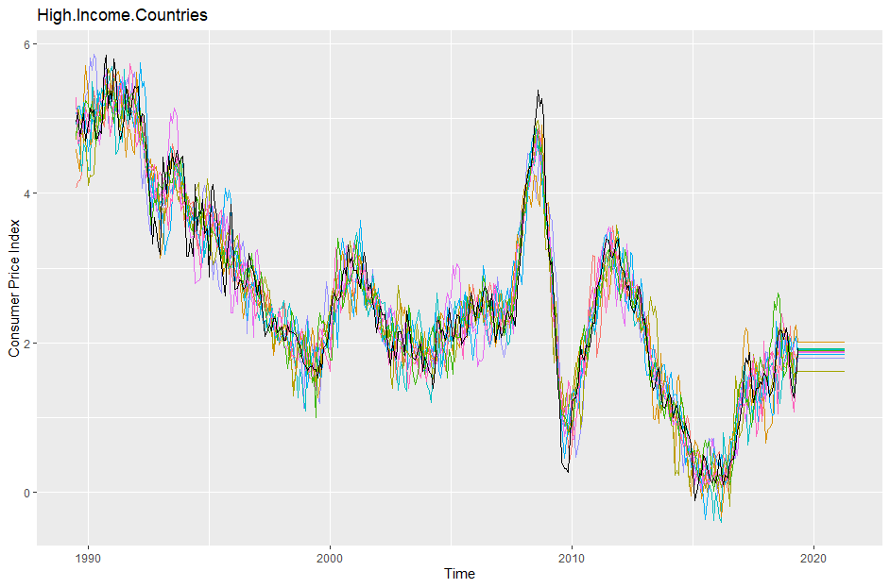

Slide 14
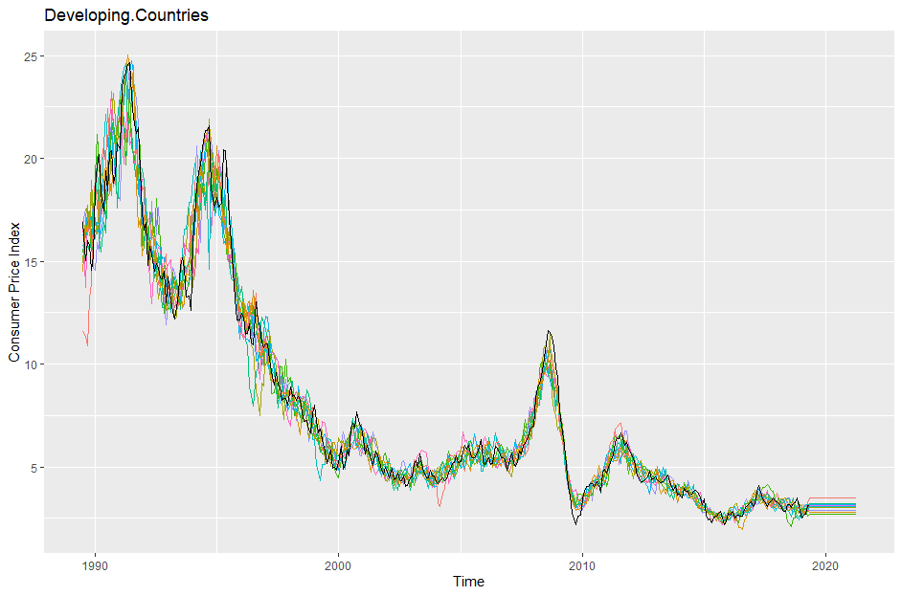

Slide 15
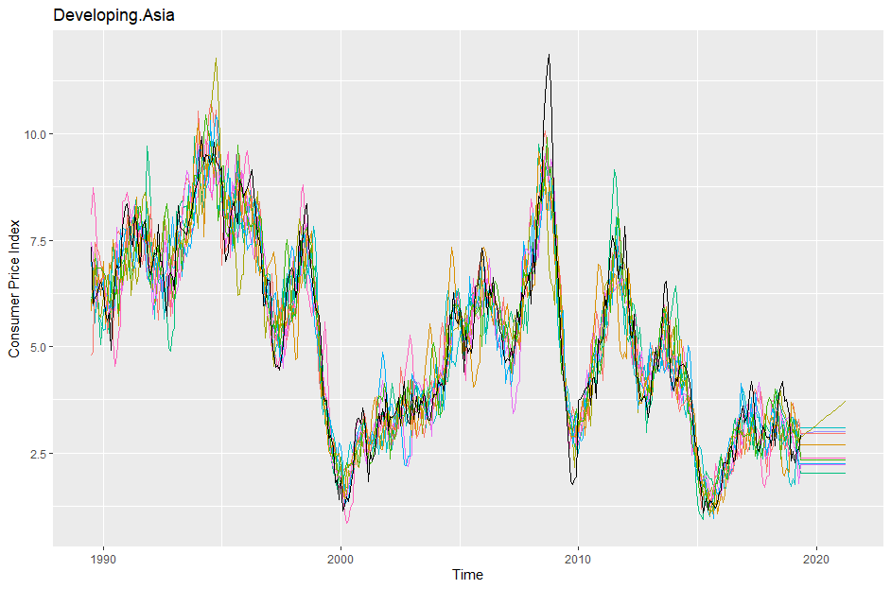

Slide 16
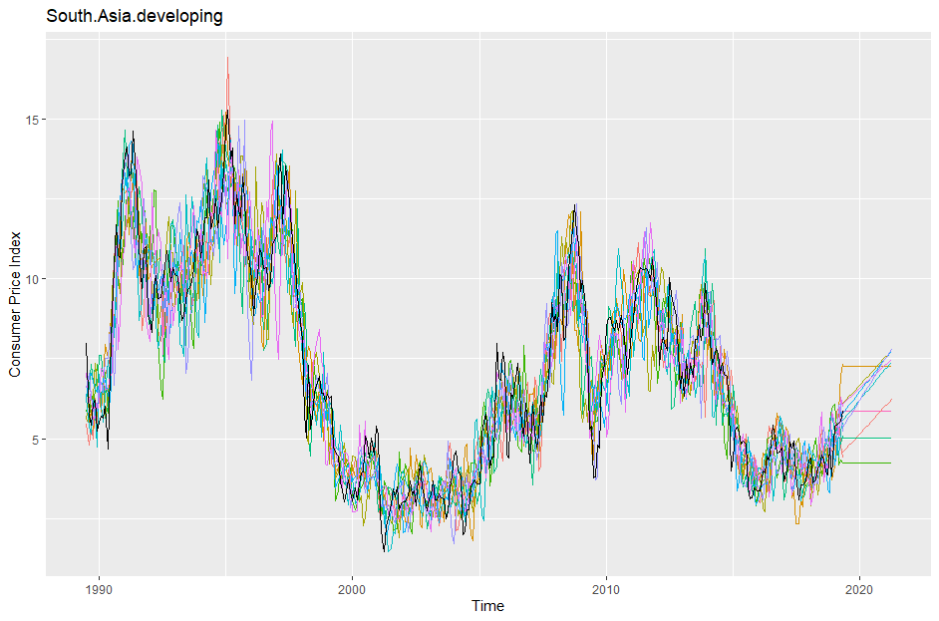

Slide 17
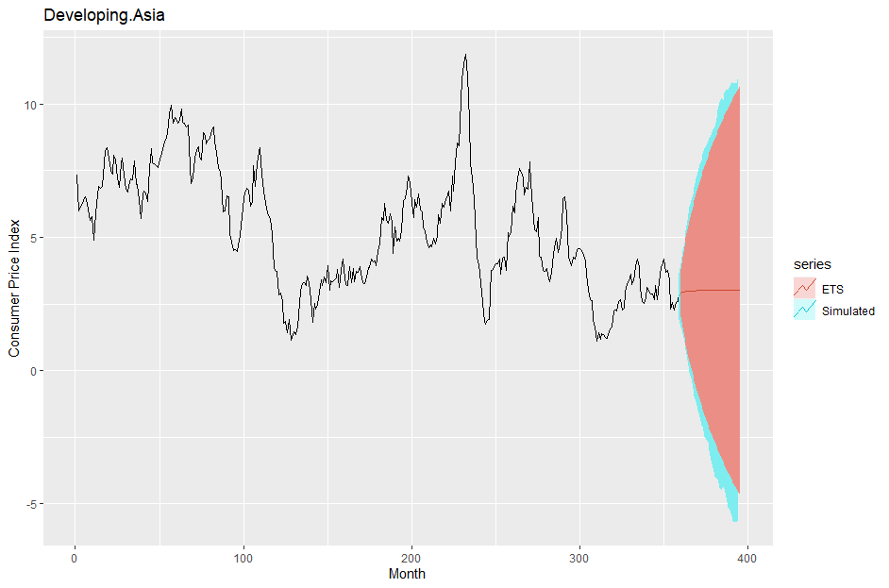

Slide 18
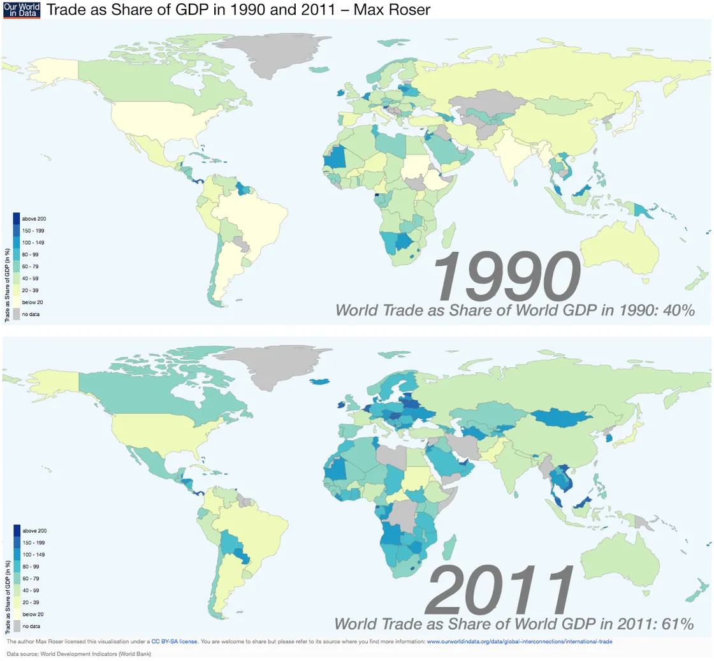
Conclusion
The Average CPI for
High Income Countries
did not match our hypothesis
decrease in the average change in prices
Middle Income Countries
did match our hypothesis
increase in the average change in prices
Developing Countries
did not match our hypothesis
decrease in the average change in prices
from the first subset of data (1989-2019) to the second subset (2012-2019).

Slide 19


Bibliography
Analytics, Moody's. “Consumer Price Index (CPI) - Country / Jurisdiction List.” Consumer Price Index (CPI) - Country List | Economic Indicators | Moody's Analytics, https://www.economy.com/indicators/consumer-price-index-cpi.
Bank, World. “Global Economic Monitor.” Kaggle, 16 May 2019, https://www.kaggle.com/datasets/theworldbank/global-economic-monitor.
Fernando, Jason. “Consumer Price Index (CPI).” Investopedia, Investopedia, 7 Apr. 2022, https://www.investopedia.com/terms/c/consumerpriceindex.asp#:~:text=The%20Consumer%20Price%20Index%20(CPI)%20is%20a%20measure%20that%20examines,of%20goods%20and%20averaging%20them.

